Slide 1


Ever felt the need for some method to keep you focused?
Have you ever
been distracted easily during online classes?

Slide 2

If you are a lecturer, ever wasted time taking attendance?

Slide 3
DistracNot Team Hocus-Focus
Faerie Srivarshan Ashvath

Slide 4
Project analysis slide 10
Challenges identified by
Students in online learning
Source : Evaluation and Improvement of students’ satisfaction in Online learning during COVID-19 | Faize | Open Praxis

Slide 5

Project analysis slide 6
Our Solution
Faculty
Prompt students with simple multiple choice questions which are generated in real-time.
Quiz
Students

Slide 6

Project analysis slide 6
Our Solution
while ( class not over )
{
if ( time == 5th minute)
{
}
}
These questions arrive periodically at regular intervals to the students.

Slide 7

Project analysis slide 6
Our Solution
if ( class over )
{
if ( score > total_questions//2 )
{
}
}
The number of questions answered correctly by a student determines his/her attendance for that class.

Slide 8
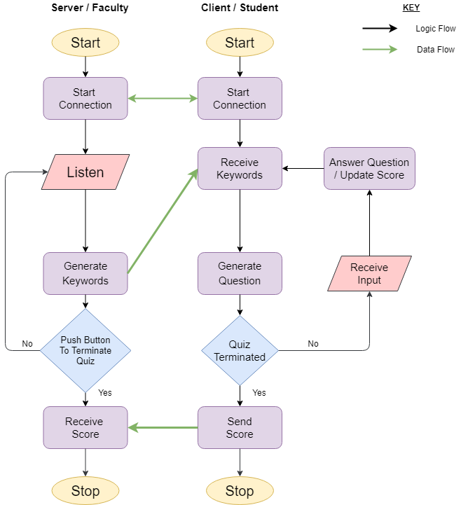
Flow Chart

Slide 9

Project analysis slide 2
Feasibility
Integration with existing software
Minimal resource utilization
DistracNot
Simple to implement
Gentle learning curve
Less maintenance
Additional server not required

Slide 10
Project analysis slide 2
Constraints
Presently supports 2 languages – Hindi and English.
The audio from the lecturer should be clear and understandable ( A good online lecture ).
Mathematics is unsupported in the current version.
Institutions where attendance is mandatory will benefit more from DistracNot.

Slide 11
Project analysis slide 2
Business Model
Presently supports 2 languages – Hindi and English.
The audio from the lecturer should be clear and understandable ( A good online lecture ).
Mathematics is unsupported in the current version.

Slide 12
Thank You

